Slide 1



SOLUTION GOAL & DESIGN CHALLENGE
HOW TO USE?
BOOTCAMP ONE | DAY THREE
HCD EXERCISE | IDEATION
FRAME GOAL & DESIGN CHALLENGE
Solution Goal
Address (Problem/Opportunity for Target User / Persona) by solving/exploring (chosen cause/reason) to achieve (Desired Results)
Objective of Exercise
To focus on the most important causes and the target audience while solving a problem. To approach problem solving in an actionable, and constrained manner.
Tools
Solution Goal, Design Challenge Statement (How Might We?)
About ‘Solution Goal’
The ‘Solution Goal’ is a statement that defines the overall strategy adopted by the problem solvers. It connects the overall problem, the cause of the problem, and the target audience.
About ‘Design Challenge’
‘How Might We?’ questions allow approaching the goal in a manner that can generate ideas. ‘How Might We?’ questions can be framed in different ways to generate different kinds of ideas and solutions.
Design Challenge 1
How Might We (potential action based on insight) to achieve Solution Goal?
Design Challenge 2
How Might We (potential action based on insight) to achieve Solution Goal?
Design Challenge 3
How Might We (potential action based on insight) to achieve Solution Goal?
Final Design Challenge
1
2
3
Solution Goal
Note down: The goal that has to be met by the solution.
Design Challenges
Frame: Versions of challenges that could help approach the solution goal.
Final Design Challenge
Choose: A final design challenge that ideas can be identified for.
*
Framing a Design Challenge
The challenge should neither be broad nor too narrow. The goal and challenge should be rooted in what is known because of research. It should also be anchored around the persona.
FINANCIAL INNOVATION LAB | BOOTCAMP ONE

Slide 2
BOOTCAMP ONE | DAY THREE
HCD EXERCISE | IDEATION
FRAME GOAL & DESIGN CHALLENGE
Notes
Session Flow
Sharing the Objective | 2 Min
Facilitators to share the objective of the session/exercise.
Walkthrough - Example | 5 Min
Facilitators to walk through 1-2 examples of the tool in use.
Walkthrough - ‘How To?’ | 5 Min
Facilitators to walk through the ‘How to?’ of the tool as per instructions on the toolsheet.
Clarifications | 3 Min
Facilitators to clarify doubts from participants.
Exercise | 15 Min
Participants to use tool with guidance from the facilitation team.
Points to Consider
The numbering provided in the How To? is a recommended path. Startups may still choose to fill the template as per their convenience.
A well framed design challenge and goal can go a long way in recognising breakthrough ideas.
There should be implicit constraints within the design challenge if possible - that makes the brainstorming process a little more focused than otherwise.
The design challenge and goal have to keep the user in mind if they have to be meaningful. Ideas should focus on making a solution work for the user or influencer that is being considered by the team.
Research insights should feed into the goal and design challenge. It should not be a statement in isolation.
The quality of research insights and learnings will be evident by the quality of design challenge they allow one to frame.
Tools
Solution Goal, Design Challenge Statement (How Might We?)
Material
Template, Chart Paper, Post-Its, Pens/ Sketch Pens
Time
30 Minutes
FINANCIAL INNOVATION LAB | BOOTCAMP ONE

Slide 3
TOOL: GOAL & DESIGN CHALLENGE
Solution Goal
Address (Problem/Opportunity for Target User / Persona) by solving/exploring (chosen cause/reason) to achieve (Desired Results)
Design Challenge 1
How Might We (potential action based on insight) to achieve Solution Goal?
Design Challenge 2
How Might We (potential action based on insight) to achieve Solution Goal?
Design Challenge 3
How Might We (potential action based on insight) to achieve Solution Goal?
Final Design Challenge
FINANCIAL INNOVATION LAB | BOOTCAMP ONE

Slide 4
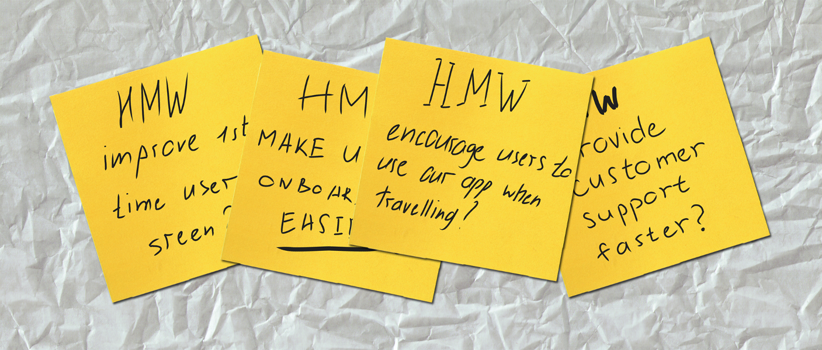
TOOL: GOAL & DESIGN CHALLENGE
FINANCIAL INNOVATION LAB | BOOTCAMP ONE

